Slide 1
PREDICTING FOREST FIRES
A project by Marwa Allam, Lisa Weiss, Sanskriti Bajaj, Sameeksha Mahajan and Gabriela Urquieta

Slide 2
OUR MOTIVATION
Forest Fires are a major environmental issue, causing economical and ecological damage.
Use Descriptive Statistics and Python Programming to work towards the prediction of such catastrophic events.
Experiment with different Machine Learning Algorithms.
INITIAL QUESTIONS
Before starting the project we formulated the following questions :
Which Machine Learning Model is the best for predicting Forest Fires ?
Which months report the highest number of Forest Fires ?
Which days report the highest number of Forest Fires ?

Slide 3
MACHINE LEARNING PROCESS
Cleaning
Data
Building ML Models
Evaluating Results
Gathering Data
We have used the Forest Fires open Data set from UCI Machine Learning Repository.
The Data set enlists features that affect the occurrence of Forest Fires, like rain, wind and temperature.
We performed Exploratory Data Analysis and found outliers as well as some unimportant features.
We transformed the data by normalization and one hot encoding.
Each member chose different ML models, allowing us to explore several algorithms like Regression,Neural Networks, Lasso and SVM.
We used Python Libraries like Scikit Learn and Keras.
Through comparison of the mean squared error (as an evaluation criteria) and plots of predicted data vs test data, we could determine which algorithms produced better results.
Data Visualizations
Using Python Libraries like Matplotlib and Seaborn

Slide 4
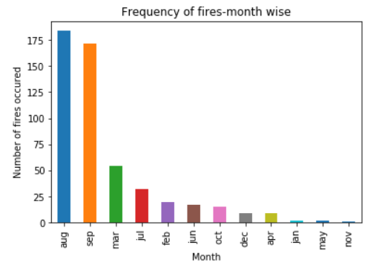
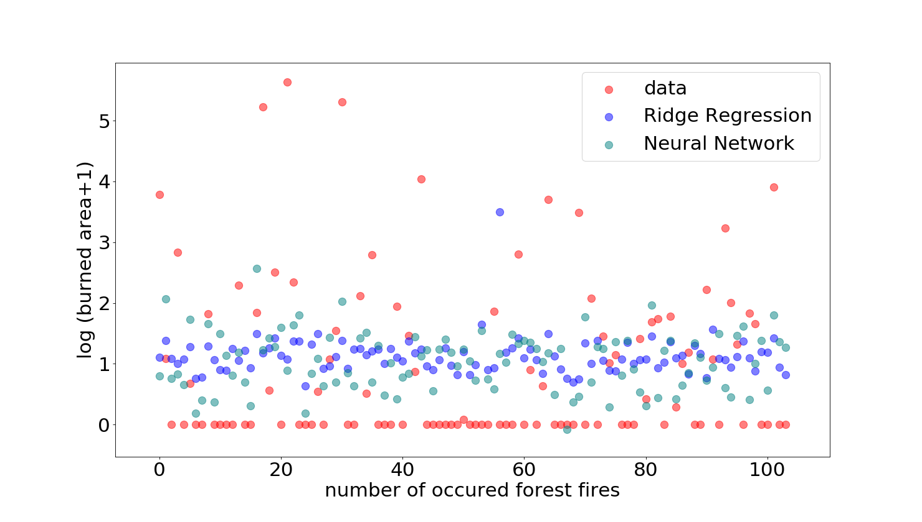
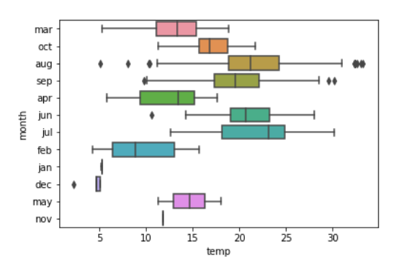
VISUALIZATION OF RESULTS
Exploring the data:
Occurence of Forest Fires per month
Predicting the burned area caused by forest fires using Neural Networks and Ridge Regression
Illustrating the temperature in each month to find the outliers in the data

Slide 5

CONCLUSIONS
DAYS WITH MOST NUMBER OF FOREST FIRES
MONTHS WITH MOST NUMBER OF FOREST FIRES
BEST ML MODELS FOR PREDICTION
FRIDAY
SUNDAY
AUGUST
RIDGE REGRESSION
SATURDAY
SEPTEMBER
NEURAL NETWORK

Slide 6





WORLDWIDE WOMEN PROGRAMMERS
LISA WEISS - Germany
SAMEEKSHA MAHAJAN - India
SANSKRITI BAJAJ - India
GABRIELA URQUIETA - Bolivia
MARWA ALLAM - Egypt

Slide 7
REFERENCES
SOURCE OF DATA :
Cortez, Morais, "A Data Mining Approach to Predict Forest Fires using Meteorological Data"; 21/7/2018/,http://www3.dsi.uminho.pt/pcortez/fires.pdf
https://archive.ics.uci.edu/ml/datasets/Forest+Fires
DOCUMENTATION OF LIBRARIES USED :
http://scikit-learn.org/stable/
https://matplotlib.org/contents.html
https://keras.io/
https://seaborn.pydata.org/
https://pandas.pydata.org/
https://www.scipy.org/
http://www.numpy.org/
OTHER RESOURCES :
Jason Brownie, Why One-Hot Encode Data in Machine Learning, 21/7/18, https://machinelearningmastery.com/why-one-hot-encode-data-in-machine-learning/
Jason Brownie, Develop Your First Neural Network in Python With Keras, Step-By-Step, 21/7/18, https://machinelearningmastery.com/tutorial-first-neural-network-python-keras/
https://www.istockphoto.com/in/photo/hand-counting-three-fingers-gm471 731759-26258534 ; 21/07/2018

